Slide 1
SHOW YOUR DRUPAL 7 WEBSITE WHO”S THE BOSS!
How to take control away from the system and give it back to the users!
Stan Ascher – Senior Drupal Developer
10.09.2015

Slide 2
Phase One: IT Solutions for a Modern World

Slide 3
Phase One is a full lifecycle firm specializing in Platform as a Service (PaaS) application development, and cybersecurity solutions.
Corporate Overview
Owned by Bob Johnson, founder of BET
Founded in 1997, Washington, D.C.
200+ Employees, $50M annual revenue
Active clients in public and private sector
Currently implementing the largest Salesforce.com solution in Federal Sector
We combine strategic, architectural, and implementation capabilities in a unique way to ensure successful PaaS implementations
We run end-to-end cybersecurity programs for large clients

Slide 4
We are experts in 3 leading technologies … but know many more.
Corporate Overview
We have 50 certified employees that hold more than 100 individual certifications
Administrators, Developers, Architects, Service and Sales Cloud specialist
Currently implementing the largest Salesforce.com solution in Federal
We have proven expertise in Java, PHP, other Open Source technologies
Developed and deployed unique solutions for multi-organizational Content Management Systems (CMS)
Experience integrating CMS with Salesforce and Microsoft platforms
Developed large scale multisite solution for a major Federal agency
MS Azure Partner
Azure experts for cloud and hybrid environments
SharePoint experts

Slide 5
By default, Drupal is the boss
Introduction

Slide 6
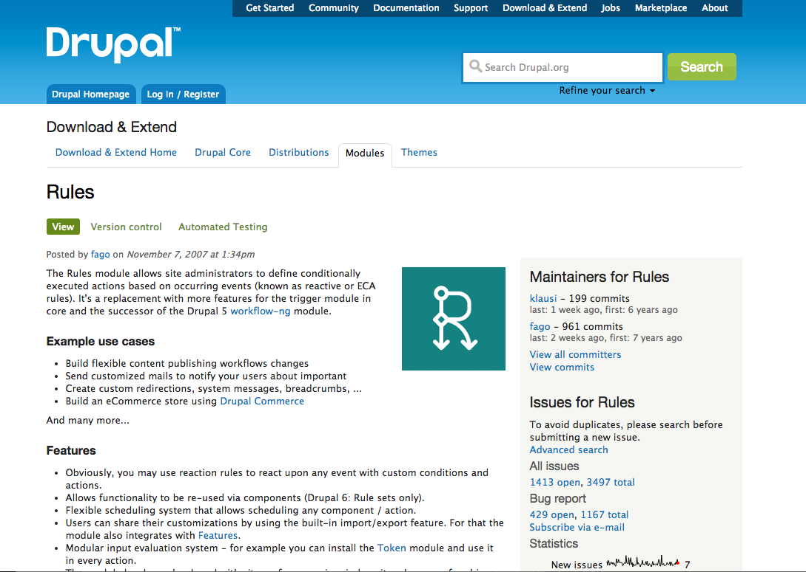

Slide 7
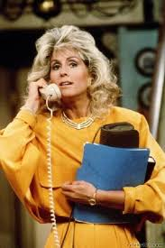
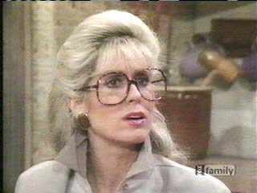
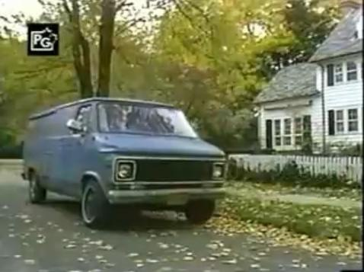
Here are six ways to say otherwise!
Introduction

Slide 8
Scenario 1: With Rules, tell Drupal how to keep the client informed.
Introduction
“I need my staff to know when someone posts a resource”

Slide 9
Scenario 2: With Rules, tell Drupal how to automate a 508 Compliance task
Introduction
“I need to make sure all images have alt text so our users with screen readers can use this.”

Slide 10
Scenario 3: With Rules and VBO, tell Drupal to engage our business users!
Introduction
“Surprise! I need someone to tag a whole bunch of nodes as letters- Oh, you want me to do it?”

Slide 11
Scenario 4: Tell Drupal to make the client look good too!
Introduction
“I want to brag to everyone how well we are doing.

Slide 12
Scenario 5: With Rules and Views Rules, tell Drupal one way to meet FISMA requirements
Introduction
“The Gov’t client wants to archive some of these, delete the rest once they’re past date!

Slide 13
Scenario 6: With Conditional Rules tell Drupal to save tedious work.
Introduction
“If I create an event tagged as planning, I want to create a resource at the same time.
if you create an event tagged as seminar, I want to create an article at the same time

Slide 14
With Rules, Drupal wasn’t the boss
Introduction

Slide 15
I WAS THE BOSS!
Introduction
And I’ll show you how you can be the boss too!

Slide 16
Here’s some assumptions:
Introduction
You have set up at least one Drupal site
You have used the views module
You have heard of the rules module
You have a need to automate some tasks on your Drupal site

Slide 17
Scenario 1:
How to use Rules to keep the client informed

Slide 18
Examples of Basic Rules Construction
Examples of Basic Rules Construction
“I need my staff to know when someone posts a resource”
Scenario 1

Slide 19
Using Rules to keep the client informed.
Examples of Basic Rules Construction
Lets Review the setup
All staff have an account on this Drupal site
With emails
All staff have a role in this Drupal site
Called, staff member
We have approved text for emails
Someone posted a message at X time titled Y with the body of Z
Scenario 1

Slide 20
Notify staff members when a resource is posted
Examples of Basic Rules Construction
One Event
Saving new Content
One Condition
Content is of Type
One Action
Send email to all users of a role
Scenario 1

Slide 21
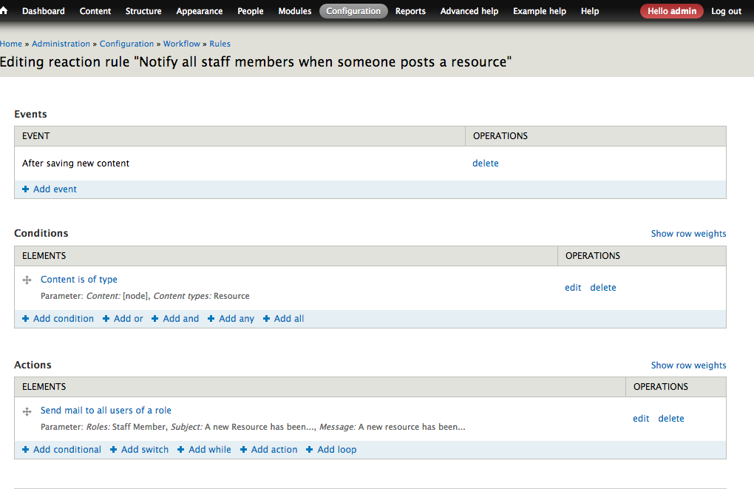
Notify all staff members when someone posts a resource
Examples of Basic Rules Construction
Pretty Easy!
Scenario 1

Slide 22
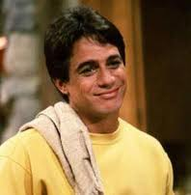
Scenario 2:
One way to use rules to automate 508 Compliance

Slide 23
Another example of basic rules construction
Another Example of Basic Rules Construction
“I need to make sure all images have alt text”
Scenario 2

Slide 24
Use rules to automate 508 Compliance
Another Example of Basic Rules Construction
Lets Review the setup:
Section 508 compliance
Images all need to have alt text for screen readers
Use alt tag function of Image module!
Alt text field can be set on the image field settings on the entity form
May need to be done retroactively
What if you have 8,000 nodes?
Scenario 2

Slide 25
Automatically create alt text for Images based on the node title
Another Example of Basic Rules Construction
A look inside the rule:
Two Events
Content is updated
Content is saved
Two Conditions
Content is of type
Data Value is Empty
One Action
Set a data value
Scenario 2

Slide 26
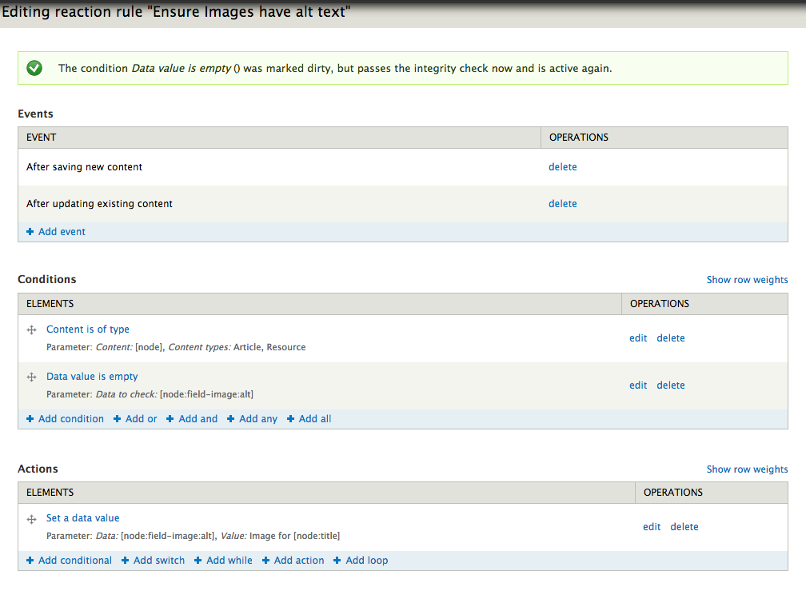
Use rules to help automate 508 compliance
Another Example of Basic Rules Construction
Here’s the Rule
Scenario 2

Slide 27
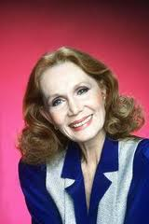
Scenario 3:
How to put business users in control
(and free up your developers)
With Views Bulk Operations (VBO)

Slide 28
Using Rules Components & the Views Bulk Operations Module
Using Rules Components & the Views Bulk Operations Module
“Surprise! I need someone to tag a whole bunch of nodes as letters- Oh, you want me to do it?”
Scenario 3

Slide 29
Mass add a value to a term reference field
Using Rules Components & the Views Bulk Operations Module
Let’s talk about components
Component is a part of a rule
A recyclable condition set
A recyclable action set
A rule without a trigger
Components can be triggered by other rules, the scheduler, or by the users
Scenario 3

Slide 30
Mass add a value to a term reference field
Using Rules Components & the Views Bulk Operations Module
Let’s look at the rule:
One Condition
Entity has a field
One Action
Add item to a list
Add letter to the list of terms on the resource type term reference field
Scenario 3

Slide 31
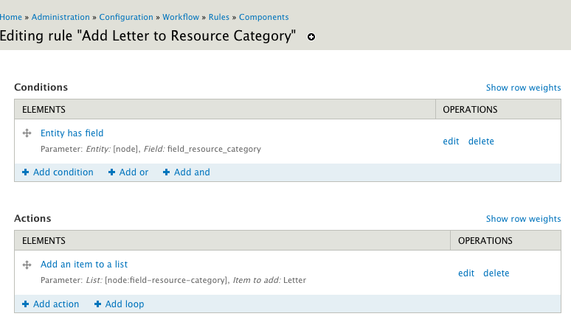
Using Rules Components & the Views Bulk Operations Module
Mass add a value to a term reference field
Scenario 3

Slide 32
Mass add a value to a term reference field
Using Rules Components & the Views Bulk Operations Module
Let’s talk about VBO:
Views Bulk Operations
Add on to rules to let users perform functions on several entitles at once
VBO is smart
A VBO field can help you apply the right component to the right entity
Scenario 3

Slide 33
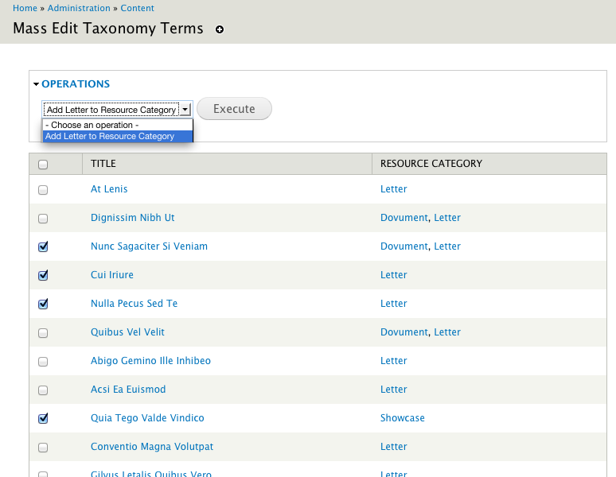
Mass add a value to a term reference field
Look at the awesome tool you gave your admins!
Scenario 3

Slide 34
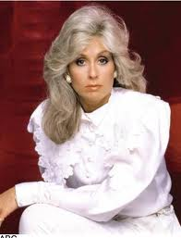
Scenario 4:
How to help the client show off so
she can get more money for
her program

Slide 35
Using the Views Rules Module
Using the Views Rules Module
“I want to brag to everyone how well we are doing. ”
Scenario 4

Slide 36
Mass add a value to a term reference field
Remember this view?
Scenario 4

Slide 37
I want to celebrate our 100th resource
Using the Views Rules Module
One Event
Content is viewed
Two Conditions
Content is of Type
Check the results of a VBO view
Comes with Views Rules Module
One Action
Show a message on the site
Scenario 4

Slide 38
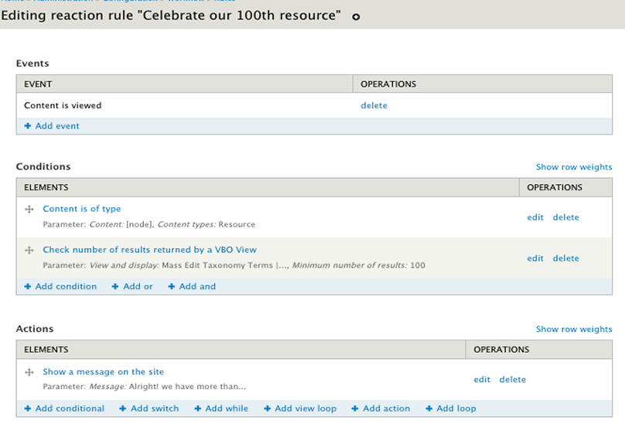
Using the Views Rules Module
Lets loop through it was rule!
Scenario 4

Slide 39
Scenario 5:
One way to get a site FISMA compliant

Slide 40
Using the Views Rules Module: another example
Using the Views Rules Module: Another example
“The GPO wants to archive some of these, delete the rest once they’re past date! ”
Scenario 5

Slide 41
Once an event is past, delete it if it’s not archived
Using the Views Rules Module: Another example
Let’s look at the situation:
All Event nodes have a checkbox field to mark it as archived
Some events contain PII and need to deleted from the site.
The client wants to be engaged in the process.
Gave them an easy to understand interface
Added benefit of ease when passing to next developer.
Scenario 5

Slide 42
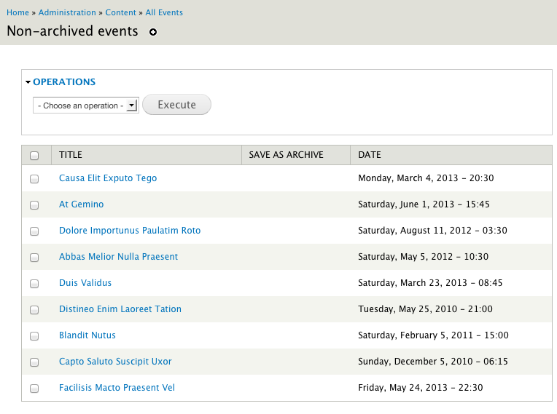
Once an event is past, delete it if it’s not archived
What a view!
Two Triggers
Cron Maintenance task are performed
No Conditions
One Action
Load a VBO view
One Loop
Delete all entitles from that loaded VBO view
Scenario 5

Slide 43
Once an event is past, delete it if it’s not archived
Using the Views Rules Module: Another example
One Trigger
Cron Maintenance task are performed
No Conditions
One Action
Load that VBO view
Comes with Views Rules Module
One Loop
Delete all entitles in that VBO view
Scenario 5

Slide 44
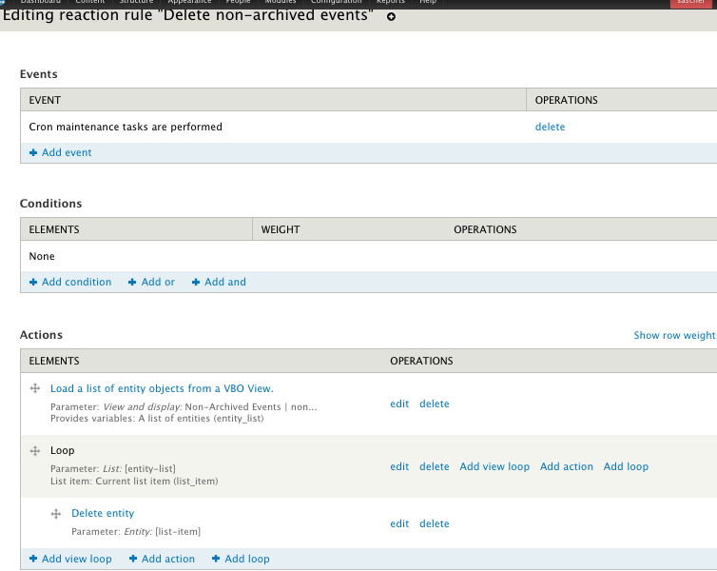
Once an event is past, check it to see if it’s archived
Lets loop a rule through it!
Two Triggers
Cron Maintenance task are performed
No Conditions
One Action
Load a VBO view
One Loop
Delete all entitles from that loaded VBO view
Scenario 5

Slide 45
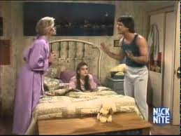
Scenario 6:
How to use conditional rules to save business users tedious work

Slide 46
Conditional Rules Module in action!
Conditional Rules Module in action!
“If you create an event tagged as planning, I want to create a resource, if you create an event tagged as seminar, I want to create an article”
Scenario 6

Slide 47
Creating corresponding content
Conditional Rules Module in action!
One Trigger
Content is saved
One Condition
Content is of type
One Action
Conditional with two if statements
If event is planning meeting make resource
If(else) event is seminar make article
Scenario 6

Slide 48
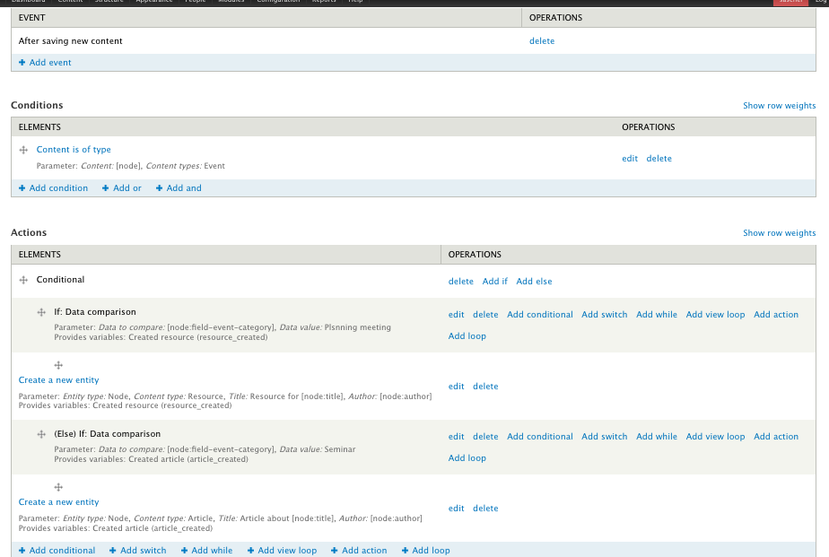
Creating corresponding content
Conditional Rules Module in action!
Here’s The Rule
One Trigger
Content is saved
One Condition
Content is of type
One Action
Conditional with two if statements
If event is planning meeting make resource
If(else) event is seminar make article
Scenario 6

Slide 49
Use Conditional Rules to cut down on your Reaction Rules
Conditional Rules Module in action!
”Holy Crapoli!
Look at all these reaction rules!

Slide 50
Use Rules with other modules
Use Rules with other modules
Workbench Webform Drupal Commerce Content Access Flag Organic Groups Token Ubercart Voting Twitter Features Context Message

Slide 51
In Conclusion
In Conclusion
Basic Rules can do a lot out of the box
Sent out specialized emails
Automatically fill in fields
VBO lets us build great admin views
Get Business users into act and save developer time.
Views Rules Module lets you leverage views
Act upon number of results in a view
Loop through a view and take action
Conditional Rules Module lets you branch out your rules
Create complicated logic in one rule
Reduce strain on your resources by turning reaction rules into components and then acting on those components with a conditional rule.

Slide 52
Special Thanks to these folks
Klaus Purer
(klausi)
Rules Module:
Wolfgang Ziegler
(fago)

Slide 53
Special Thanks to these folks
Views Bulk Operations Module:
Karim Ratib
(INFOJUNKIE)

Slide 54
Special Thanks to these folks
Views Rules Module &
Conditional Rules Module
Taihao Zhang (zhangtaihao)

Slide 55
Special Thanks to these folks
Rules Tutorials
Johan Falk
(Itangalo)

Slide 56
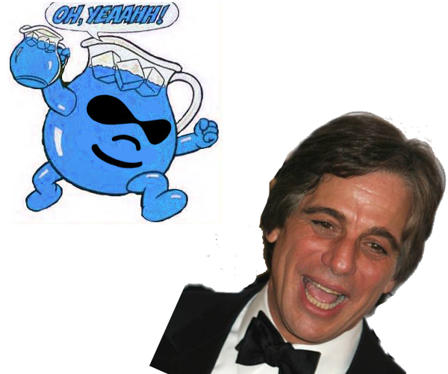
BE THE BOSS
WITH RULES!
Check the website for this presentation and downloadable features
10.09.2015

Slide 57
Questions?
Questions?
Contact me:
Drupal.org: sascher
Email: sascher@phaseonecg.org
?

